Slide 1
Software Engineering (IT-304)
Project work under guidance of : Mr. Santosh ray
Submitted by:
Varun Kumar: 2K19/IT/140
Yashit Kumar: 2K19/IT/149

Slide 2
TOPIC
Clubhouse – Social Media Application

Slide 3
INTRODUCTION
Online Social Networking was developed to serve as a medium to connect people from various walks of life from various parts of the world.
Social networking applications are so prevalent in the world today that it has helped individuals as well as large corporate in one way or the other and also proved to be a cost effective way to bring the world together.
So in this project we had made a website to provide a connectivity between the users and try to connect people from different area and network , where every individual has the benefit of uploading and retrieving data and also provides facilitates the sharing of ideas, thoughts, and information through the building of virtual networks and communities.

Slide 4
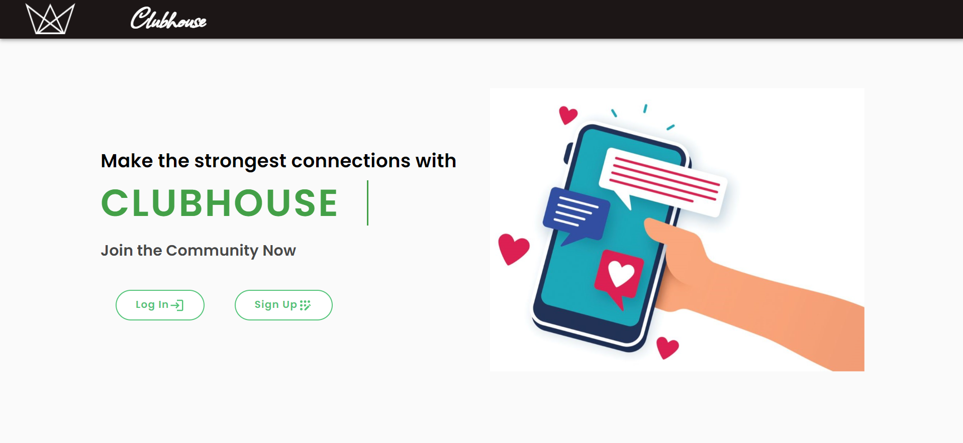

Slide 5
OBJECTIVE AND SCOPE
The main objective of the project is to establish a network among the people residing in all over the world. All the information can be easily accessed and shared among the people.
To have attractive and Secure Login page to access
Make new user account in more user friendly and proper validation of details
Search People easily on entire network
Follow other users to make friends.

Slide 6
Creating a public profile having social, professional and personal information
Ease of editing of profile anytime
Chat with Online friends
Upload and Share Images on network
Send messages to other friends
Like and comment on other users post.
Receive notifications about like, comment and new follower.

Slide 7
OPERATING ENVIRONMENT
Server Side:
➔ Processor : Intel® Core™ i7-9750H CPU @ 2.60GHz
➔ RAM: 8.00 GB
➔ OS: Windows 10 Home
➔ Database: MongoDb Atlas
➔ Application: Node.js (for creating our web server), Mongodb Compass server (GUI for Managing Database), Heroku Server (for Hosting
website).
➔ IDE: Visual Studio Code

Slide 8
Client Side (minimum requirement):
➔ Processor: Intel Dual Core
➔ HDD: Minimum 1GB Disk Space free
➔ RAM: Minimum 1GB
➔ OS: Windows 7, 8, 8.1, 10, Linux.
➔ Browser: Chrome Recommended

Slide 9
TECHNOLOGIES USED
FRONTEND
Next.js
React.js
Material UI
Bootstrap
HTML
CSS

Slide 10
TECHNOLOGIES USED
BACKEND
Node.js
Express.js
MongoDB
Socket.io
Cloudinary

Slide 11
SDLC MODEL
Iterative and Incremental development is a combination of both iterative design or iterative method and incremental build model for development.
In this incremental model, the whole requirement is divided into various builds. During each iteration, the development module goes through the requirements, design, implementation and testing phases. Each subsequent release of the module adds function to the previous release.
The process continues till the complete system is ready as per the requirement.

Slide 12
Functional Requirements
Sign up and Sign in - We firstly made two pages, first is signup page and other is sign in page for user to make its identity and then for authentication of user to use the resources of website as user will provide his credentials for signup then using our sever we will store its identity
He will going to give his credentials to us again for sign in this time and if his entered email and passwords matches with the one our DB is storing then we send him one token that contains some user id as the matching criterion for next time when he will request ,that will be stored in cookies of his system and whenever he will be requesting next time its request will contain that cookie and we will only check that user id not the password this time . so in this fashion sign in worked for authenticating the user. Also before authentication we have made another check at sign up of validation of correct data before it will be stored in our DATABASE.

Slide 13
Post Upload – Users can upload post by writing some content and uploading the image. Other users can interact by giving likes and comments on the post
Deleting post and comments - Also we gave one delete button there just after the posts and messages to delete that post or comment That U made and that are not relevant.
Uploading image feature - Also after that we have uploading the file feature as well in our site. That we use to provide uploading avatar feature to user to change his avatar and whatever he will upload there . we will going to save that in our database and going to display that file on our site as his profile photo.

Slide 14
Chatting engine - user can do chatting with his friends that we made that gives whatsapp type of feature for chatting and you can also implement this feature using socket.io library that provides 2-way communication with the server and all the observers of that server means that helps in implementing the client – server continuously talking system.
Friendship establishing – Users can build connections by following and unfollowing the users.
Bio and other social media handle - Users can update their bio in their profile and After all of this stuff we have links provided above to just go to their facebook, Instagram, youtube page to visit about their non-private activities

Slide 15
Update password - Users can also update their password.
Notifications – Users will also get notifications whenever someone follows them or like and comment on their post.
Sign out - after this mailing techniques we have Sign out link at top – right corner of our site which will directly remove our session after clicking on to that link. And finally we will be sent back to sign in page then

Slide 16
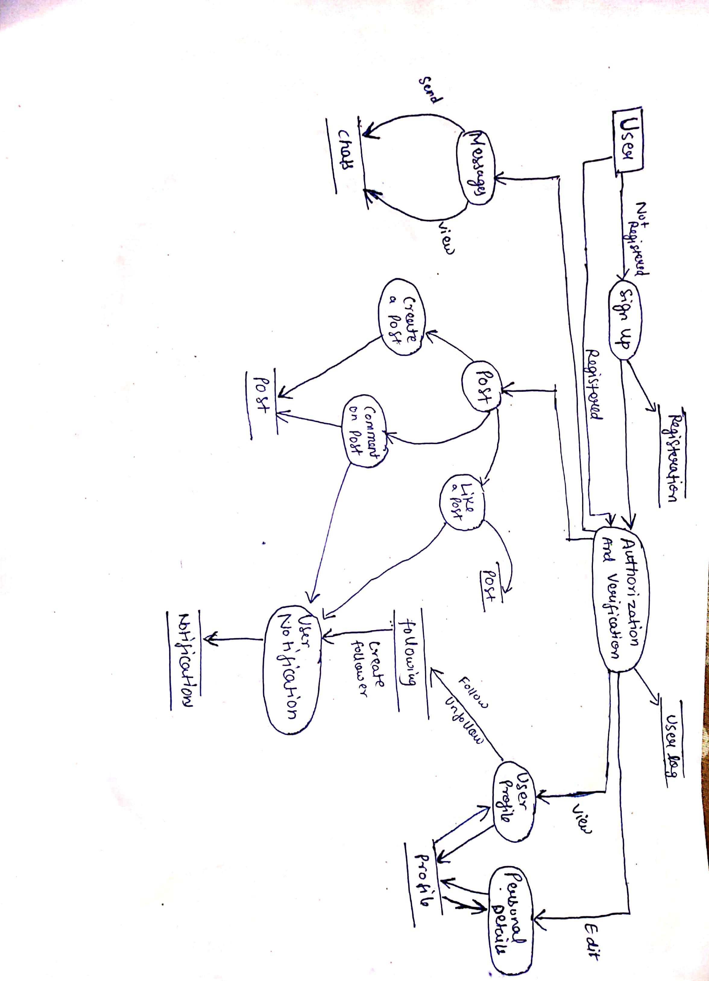
DATA FLOW DIAGRAM

Slide 17
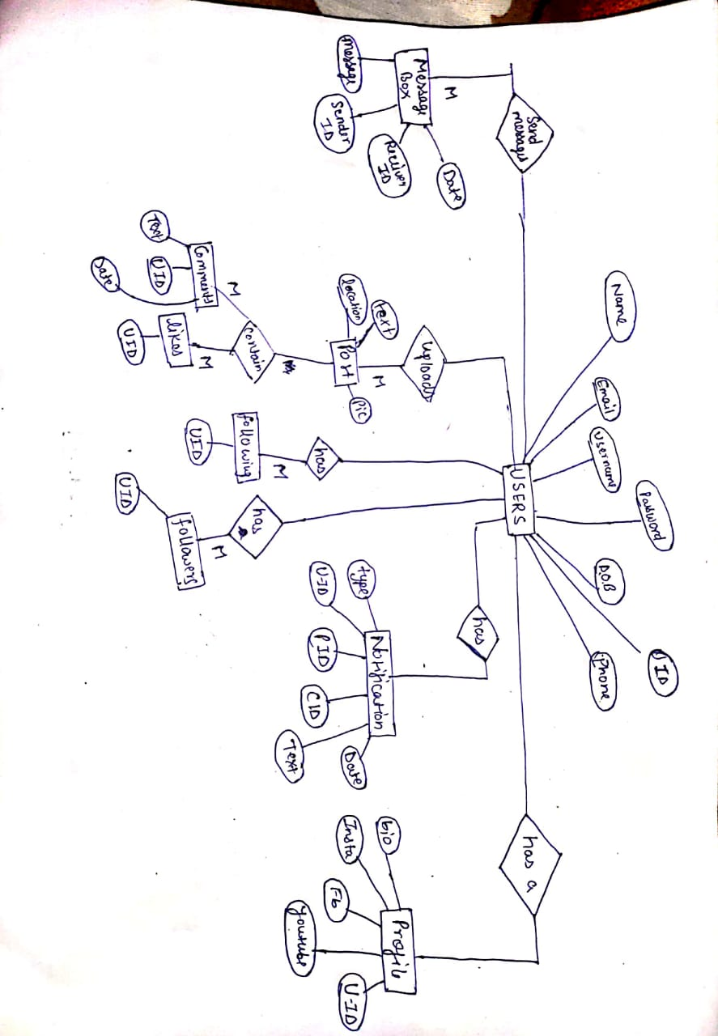
E-R DIAGRAM

Slide 18
TESTING
T ES T C A S E -1
TEST NO. 1
TEST TYPE : Unit Testing
INPUT : Password
OBJECTIVE : Checking Password Security
EXPECTED OUTPUT: Access to Authorized Users Only
ACTUAL OUTPUT : Password Security Successful
RESULT : Access to Only Authorized Users

Slide 19
T E S T C A S E -2
TEST NO. 2
TEST TYPE UNIT TESTING
INPUT : Password during Registration.
OBJECTIVE : Password must contain at least one lower case, one upper case , one numeric and one special character
EXPECTED OUTPUT : ERROR MESSAGE
ACTUAL OUTPUT : ERROR MESSAGE
RESULT : Password must contain at least one lower case, one upper case ,one numeric and special character

Slide 20
T E S T C A S E -3
TEST NO. 3
TEST TYPE UNIT TESTING
INPUT : Username during Registration.
OBJECTIVE : Username should be unique and contain only alphanumeric and underscore.
EXPECTED OUTPUT : ERROR MESSAGE
ACTUAL OUTPUT : ERROR MESSAGE
RESULT : Username is already taken.

Slide 21
CONCLUSION
So we conclude that in this project user is authenticated before making the entry to the network and have the privilege to communicate , with other users and share thoughts , ideas, and information through the virtual networks .
It is internet-based and gives users quick content. Content includes personal information, documents, and photos.
Users engage with social media, often utilizing it for messaging.
So it is the perfect and the secure way of self presentational and to connect people and a good social tool.
A large number of corner cases have been covered in the source code making it less likely to cause problem in case of abnormal input this makes it handy and reduce user dependency for its working

Slide 22
Future Work
1. Developing the channels so that users can chat in group.
2. Introducing voice group chat so that users can have group calls and have fun in realtime.
3. Implementing friend recommendation system based on mutual connections.
4. Implementing Real time notifications using socket io.

Slide 23
REFERENCES
Source Code - https://github.com/varunkmr038/Clubhouse
https://en.wikipedia.org/wiki/Social_media
https://www.geeksforgeeks.org/mern-stack/
https://www.javatpoint.com/software-requirement-specifications
https://www.tutorialspoint.com/socket.io/index.htm
https://www.tutorialspoint.com/mongodb/index.htm
https://medium.com/code-dementia/building-a-social-network-using-mern-stack-85037914b944
https://en.wikipedia.org/wiki/Data-flow_diagram

